Slide 1
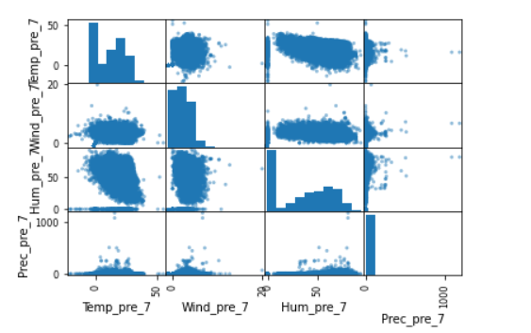
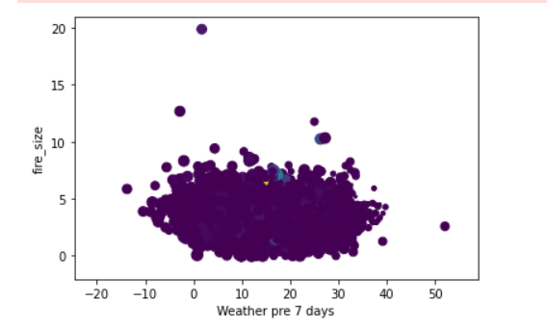
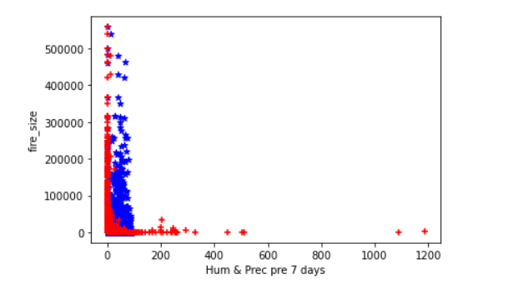
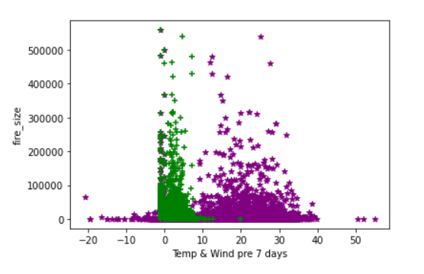
Predicting the Possibility of Wildfires in the US
Shiva Rama Krishna Vodnala
Github: https://github.com/srkvodnala
Wildfires are a huge liability to any country’s economy. I have used machine learning methods to find the correlation between weather conditions and the fire sizes. The results would be helpful to predict the possibility of a fire before it appears, which would help the local authorities to prepare for these fires prior to the accidents.
Classification using Kmeans + PCA on training sets.
The first two graphs show the 4 features: temperature, humidity, wind and precipitation vs fire size without any methods applied.
The last two graphs show humidity + precipitation vs fire size and temperature + wind vs fire size.
We can finally predict if the fire will happen after approximately 7 days in a particular place by recording its weather conditions which includes temperature humidity wind and precipitation. After prediction, the magnitude of the fire can also be classified as clustering methods were used. For precise predictions, further analysis can be done using weather conditions from 15 and 30 days prior to the fire recorded.
Prediction: Linear Regression.
Classification: Decision Tree Classifier, Gaussian Naive Bayes, Random Forest Classifier.
Clustering: Kmeans, PCA.
Dataset: kaggle - https://www.kaggle.com/capcloudcoder/us-wildfire-data-plus-other-attributes
Jupyter Notebook, Sklearn
I would like to thank Dr. Hoot for providing guidance through this project.
https://github.com/44-599-MachineLearning-S21/project-machine-learning-s21-srkvodnala

